Slide 1
Drifting Upstream
Predicting song popularity from music features

Slide 2
The Problem
Regression Records music label
Extra promotional budget for Q3 and Q4 of 2024
Hundreds of songs in catalog, must choose 3
Predict song popularity from music features

Slide 3
Data Wrangling & EDA Pt. 1
945 Songs
Target Variable
Total # Streams
Median ~290 million
Min ~1.4 million
Max ~3.7 billion

Slide 4
Data Wrangling & EDA Pt. 1
Features
Tempo
Danceability
Valence
Energy
Acousticness
Instrumentalness
Liveness
Speechiness
Mode

Slide 5
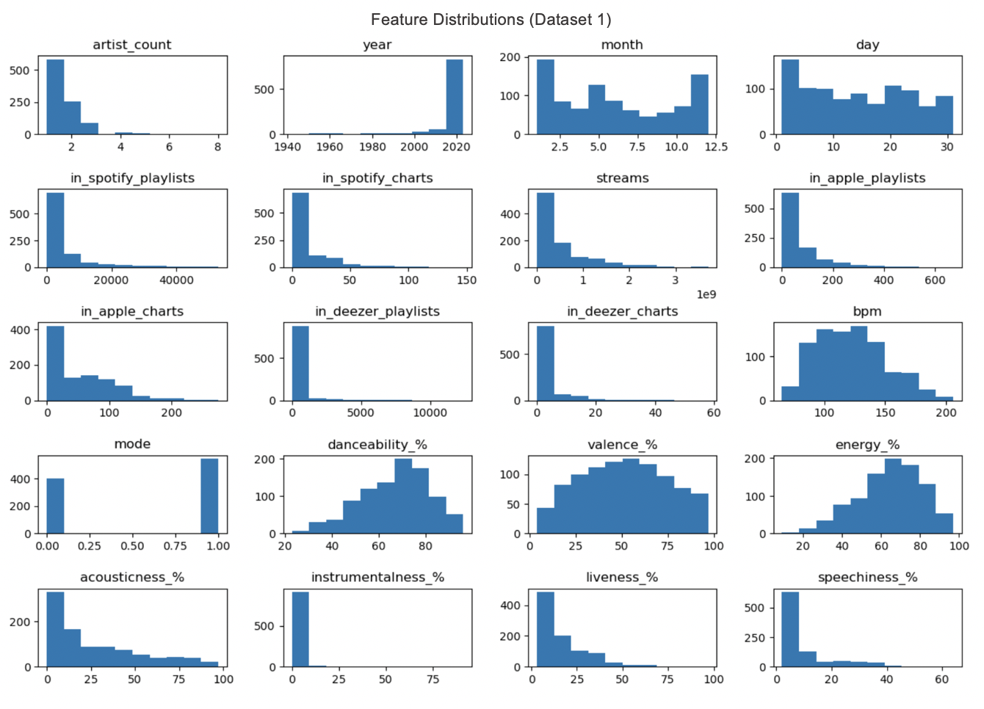

Slide 6
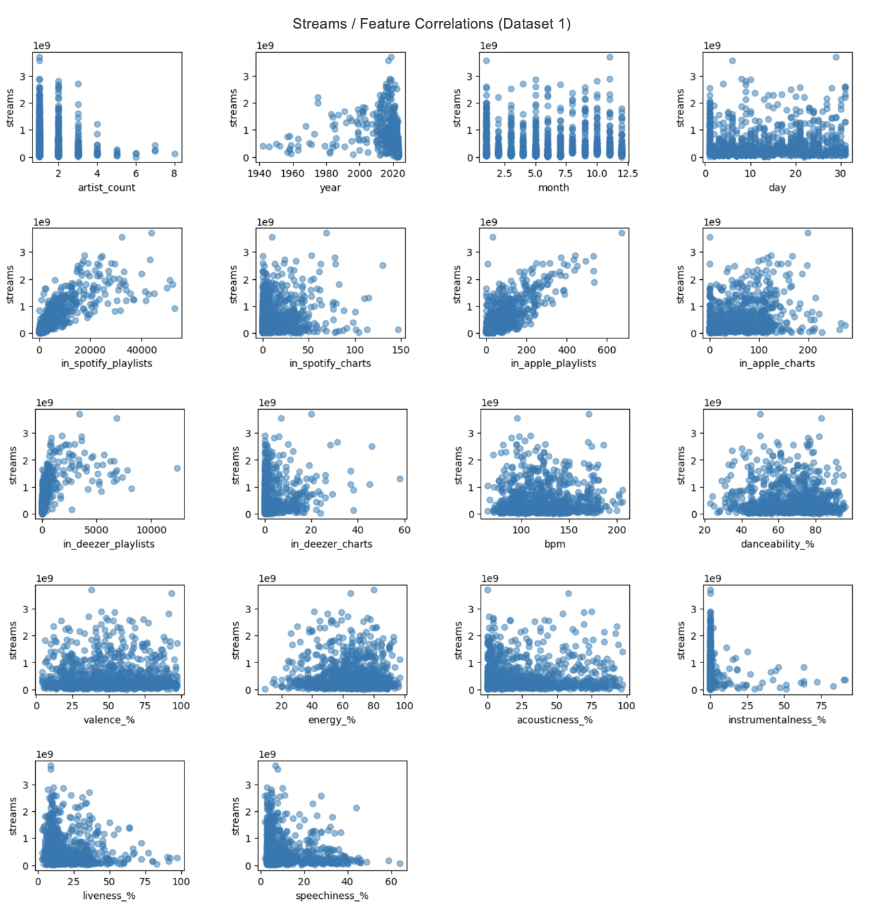

Slide 7
Modeling Pt. 1
Random Forest Regressor
Train / Test MAE 335.5M / 332.4M
Extra Trees Regressor
Train / Test MAE 0 / 340M
Gradient Boosting Regressor
Train / Test MAE 310M / 348M
(70 / 30 train test split)

Slide 8
Modeling Pt. 1
Random Forest Regressor
PowerTransformer()
Train / Test MAE 335.5M / 332.2M
90 / 10 Split
Train / Test MAE 332M / 268M
Remove top 5% outliers (80 / 20)
Train / Test MAE 247M / 270M

Slide 9
Modeling Pt. 1
Random Forest Regressor
Hyperparameters
n_estimators = 200
max_features = 6
max_depth = 30
min_samples_split = 7
min_samples_leaf = 11
random_state = 42
Feature Importance
Tempo (0.166281)
Danceability (0.161662)
Acousticness (0.155589)
Valence (0.146104)
Speechiness (0.119351)
Liveness (0.115062)
Energy (0.109871)
Mode (0.023337)
Instrumentalness (0.002743)

Slide 10
Data Wrangling & EDA Pt. 2
32,833 Songs
Target Variable
Popularity Score (1-100)
Mean 42.48
Median 45

Slide 11
Data Wrangling & EDA Pt. 2
Features
Tempo
Danceability
Valence
Energy
Acousticness
Instrumentalness
Liveness
Speechiness
Duration
Loudness

Slide 12
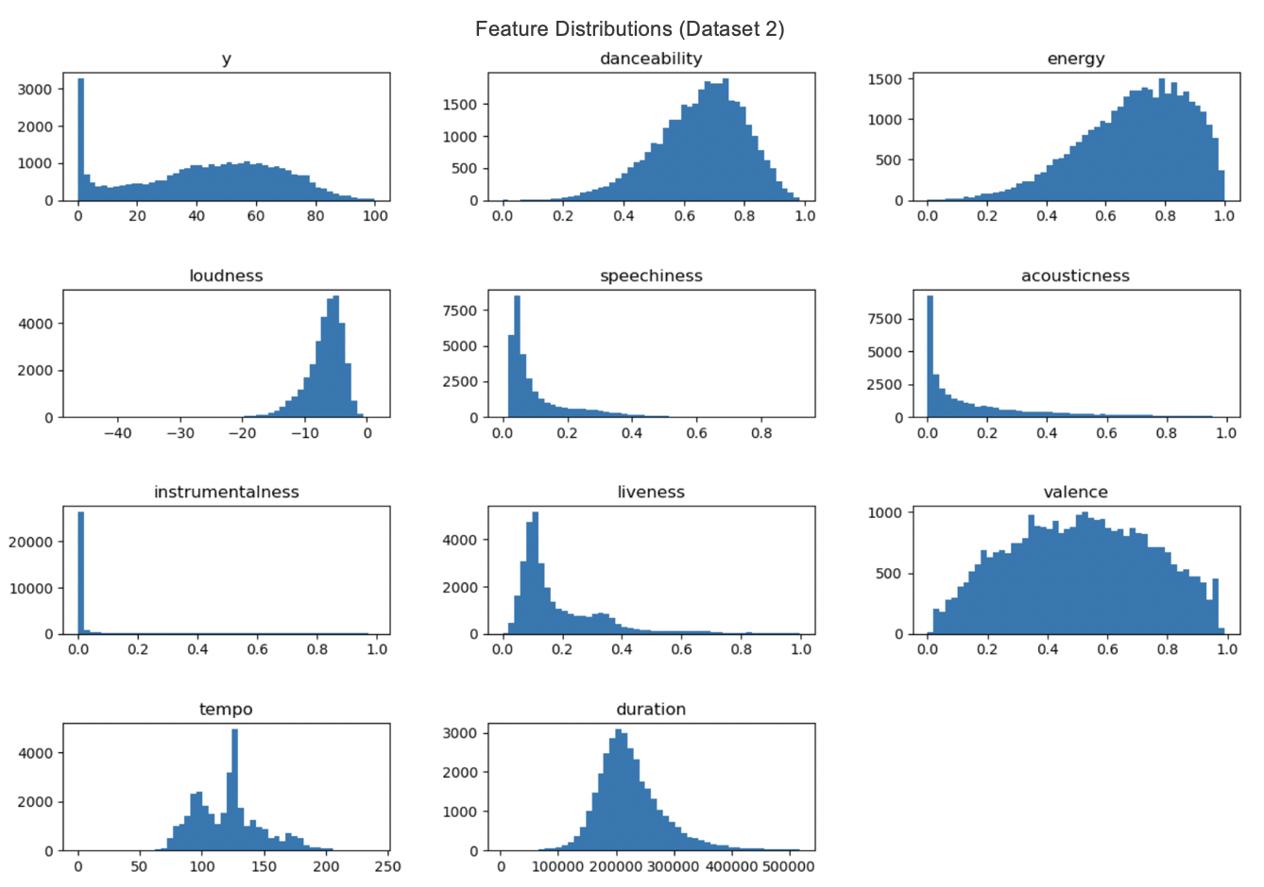

Slide 13
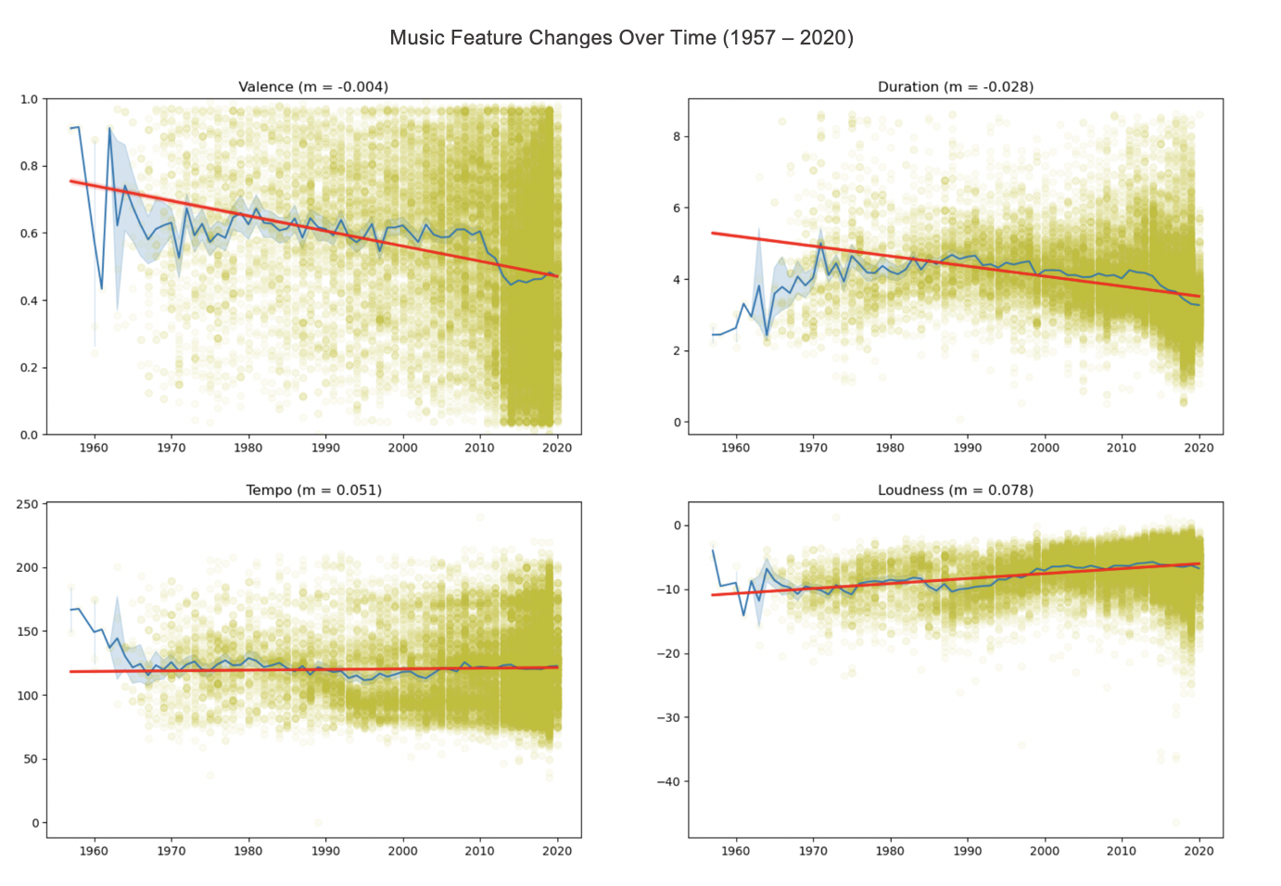

Slide 14
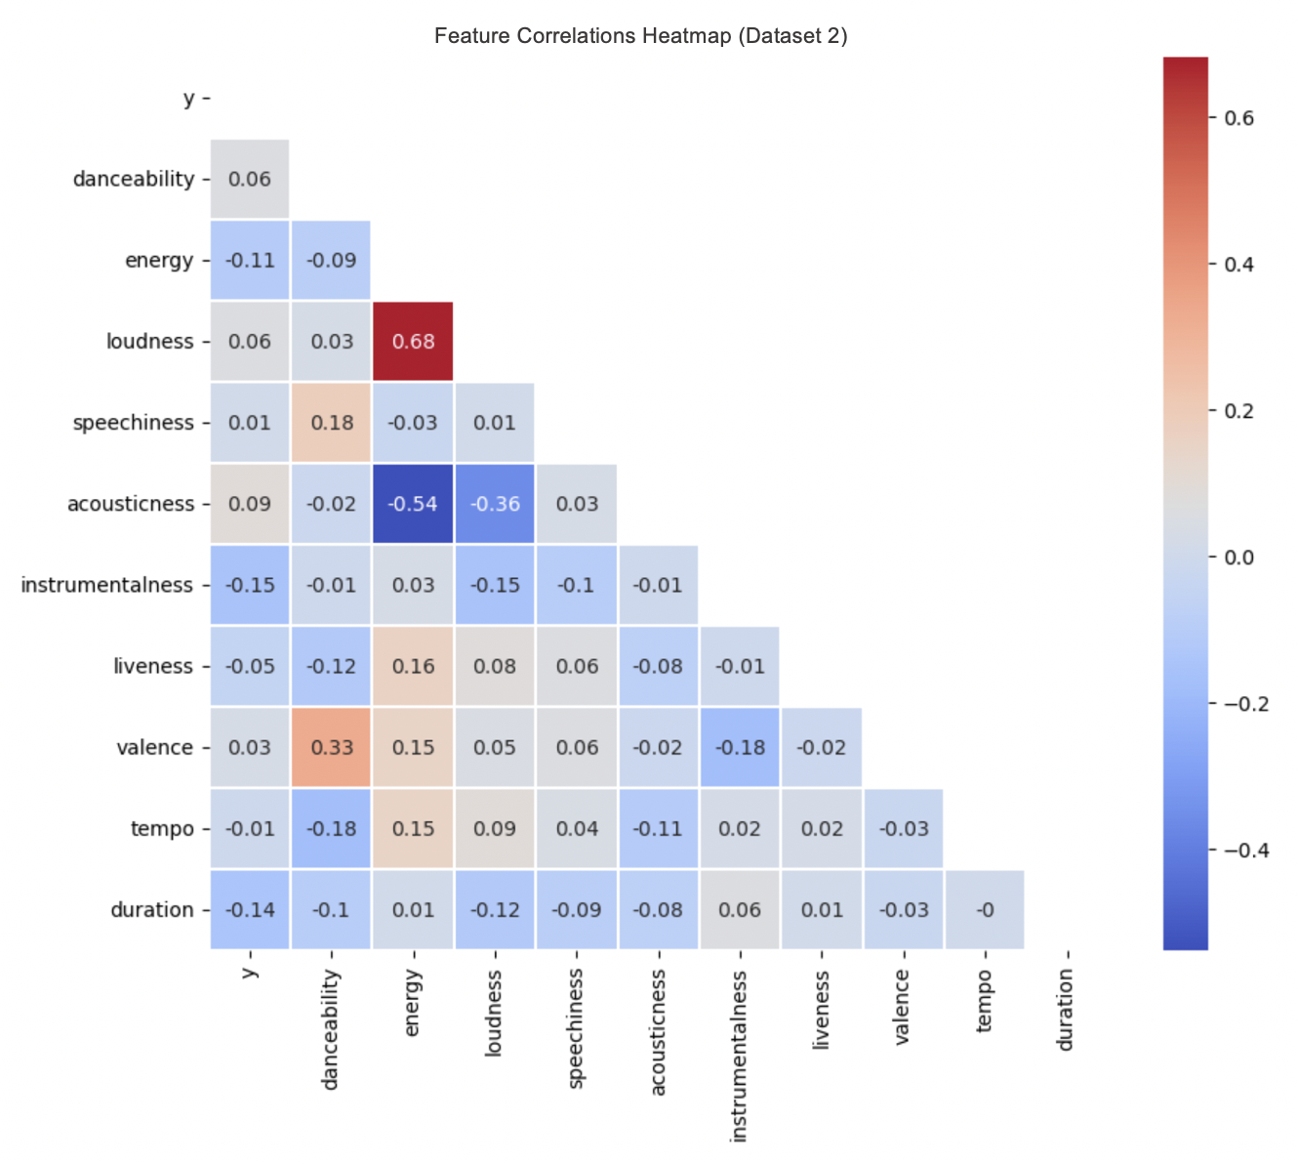

Slide 15
Modeling Pt. 2
Random Forest Regressor
Standard Scaler
CV / Test MAE 16.86 / 16.31
Extra Trees Regressor
Power Transformer
CV / Test MAE 15.94 / 15.30
Gradient Boosting Regressor
Min Max Scaler
CV / Test MAE 16.83 / 16.00
Hist Gradient Boosting Regressor
Robust Scaler
CV / Test MAE 18.24 / 17.68
XGBoost Regressor
Power Transformer
CV / Test MAE 17.62 / 17.29
(80 / 20 train test split)

Slide 16
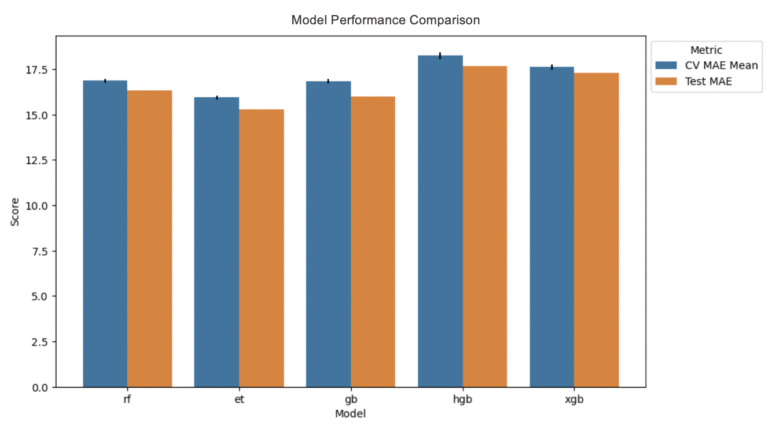

Slide 17
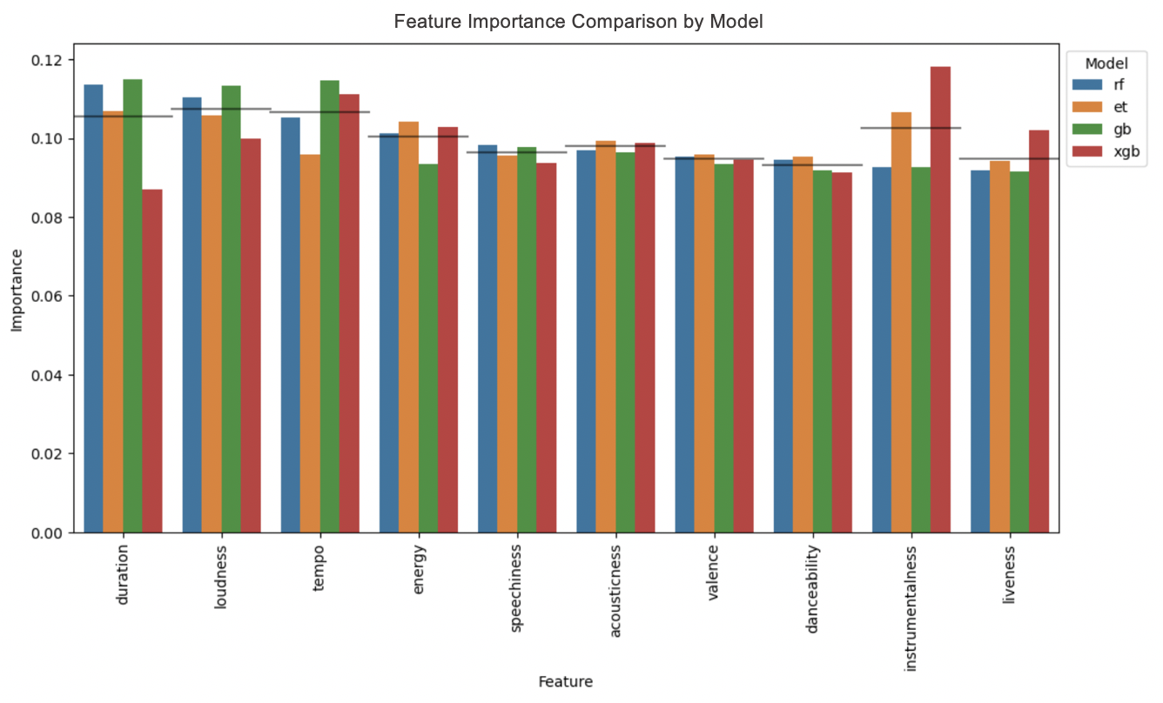

Slide 18
Modeling Pt. 2
Extra Trees Regressor
Hyperparameters
n_estimators = 1458
max_depth = 46
random_state = 42
Feature Importance
Duration (0.106840)
Instrumentalness (0.106628)
Loudness (0.105952)
Energy (0.104153)
Acousticness (0.099422)
Tempo (0.095905)
Valence (0.095804)
Speechiness (0.095739)
Danceability (0.095383)
Liveness (0.094174)

Slide 19
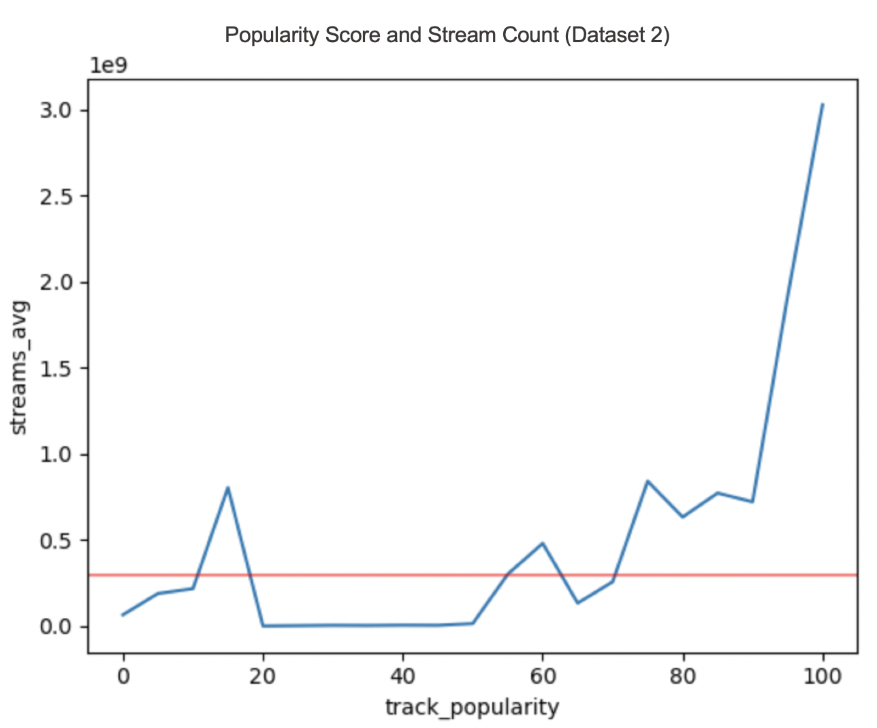

Slide 20
Conclusion
Streams / Popularity Score
Random Forest Regressor (Set 1)
Test MAE 268M
Tempo, Danceability, Acousticness, Valence
Extra Trees Regressor (Set 2)
Test MAE 15.30
Duration, Instrumentalness, Loudness, Energy
Future Work
Use current models for baseline predictions
Seek dataset with thorough observations and features
Quantify success metric

